Slide 1
The frontal lobes of the brain and their impact on medicine, the law and society
Richard W Frith

Slide 2
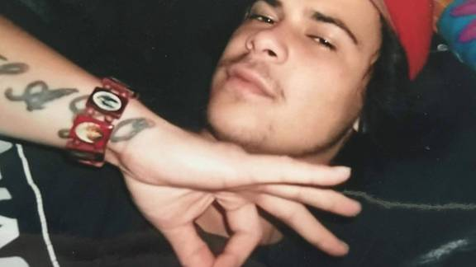

Slide 3
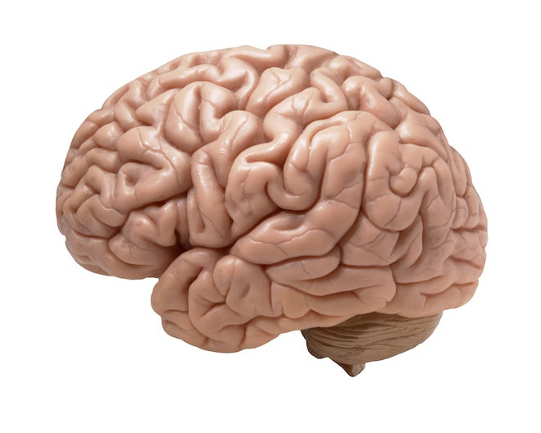

Slide 4
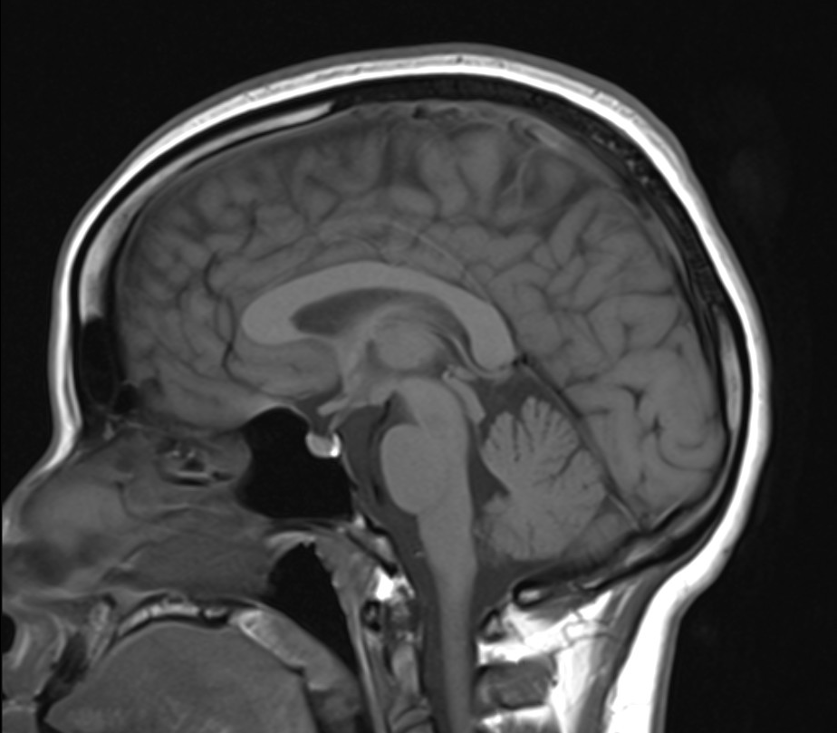
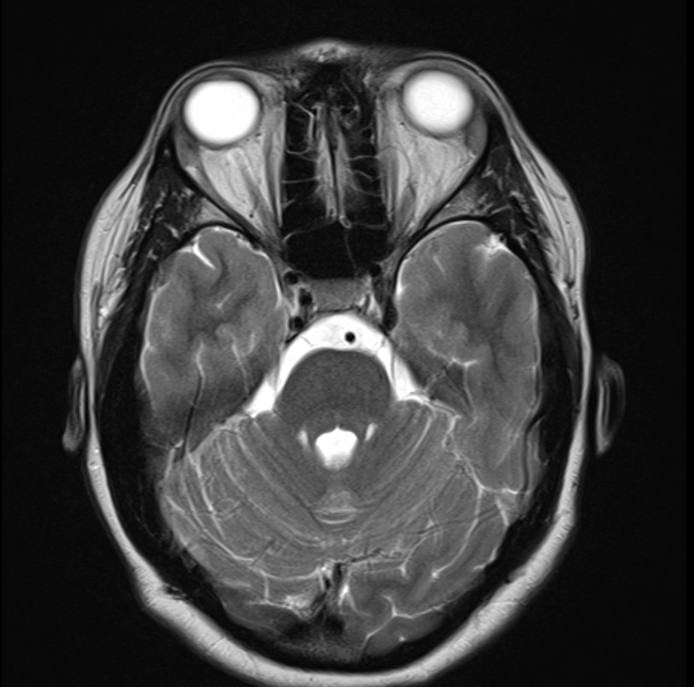

Slide 6
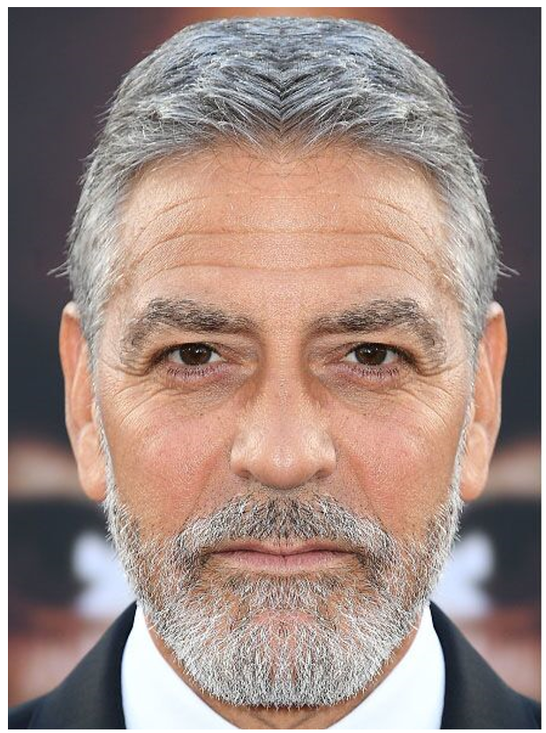

Slide 7
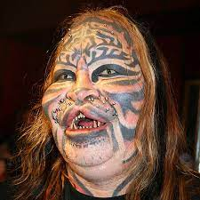

Slide 14
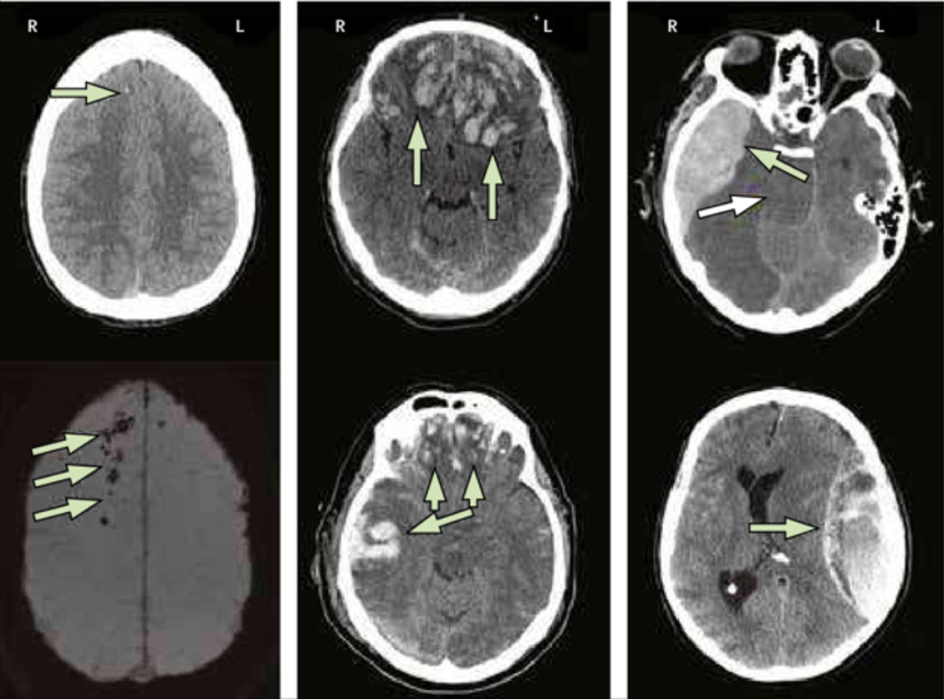

Slide 20
“It is not known if Rosemary herself was consulted; but the result was devastating for her. After the operation, her mental capacity diminished to that of a two-year-old baby who was no longer able to walk or talk. One of her legs was permanently turned inward. It took months of therapy before she could partially use her one arm or move around on her own. When she regained her voice, only garbled sounds came out of her throat.”

